Slide 1
CSS for Styling

Slide 2
Cascading Style Sheets (CSS)
Describes the appearance, layout, and presentation of information on a web page
HTML describes the content of the page
Describes how information is to be displayed, not what is being displayed
Can be embedded in HTML document or placed into separate .css file

Slide 3
Basic CSS rule syntax
selector {
property: value;
property: value;
...
property: value;
} CSS
p {
font-family: sans-serif;
color: red;
} CSS
A CSS file consists of one or more rules
Each rule starts with a selector
A selector specifies an HTML element(s) and then applies style properties to them
a selector of * selects all elements

Slide 4
Attaching a CSS file <link>
<head>
...
<link href="filename" type="text/css" rel="stylesheet" />
...
</head> HTML
<link href="style.css" type="text/css" rel="stylesheet" />
<link href="http://www.google.com/uds/css/gsearch.css"
rel="stylesheet" type="text/css" /> HTML
A page can link to multiple style sheet files
In case of a conflict (two sheets define a style for the same HTML element), the latter sheet's properties will be used
Notes:
a conflict (two sheets define a style for the same HTML element

Slide 5
Embedding style sheets: <style>
<head>
<style type="text/css">
p { font-family: sans-serif; color: red; }
h2 { background-color: yellow; }
</style>
</head>
HTML
CSS code can be embedded within the head of an HTML page
Bad style and should be avoided when possible (why?)

Slide 6
Inline styles: the style attribute
<p style="font-family: sans-serif; color: red;">
This is a paragraph</p>
HTML
This is a paragraph
output
Higher precedence than embedded or linked styles
Used for one-time overrides and styling a particular element
Bad style and should be avoided when possible (why?)

Slide 7
CSS properties for colors
p {
color: red;
background-color: yellow;
}
CSS
This paragraph uses the style above output
property | description
color | color of the element's text
background-color | color that will appear behind the element

Slide 8
Specifying colors
p { color: red; }
h2 { color: rgb(128, 0, 196); }
h4 { color: #FF8800; } CSS
This paragraph uses the first style above
This h2 uses the second style above.
This h4 uses the third style above.
output
color names: aqua, black, blue, fuchsia, gray, green, lime, maroon, navy, olive, purple, red, silver, teal, white (white), yellow
RGB codes: red, green, and blue values from 0 (none) to 255 (full)
hex codes: RGB values in base-16 from 00 (0, none) to FF (255, full)

Slide 9
Grouping styles
p, h1, h2 {
color: green;
}
h2 {
background-color: yellow;
} CSS
This paragraph uses the above style.
output
This h2 uses the above styles.
A style can select multiple elements separated by commas
The individual elements can also have their own styles

Slide 10
CSS comments /*…*/
/* This is a comment.
It can span many lines in the CSS file. */
p {
color: red; background-color: aqua;
} CSS
CSS (like HTML) is usually not commented as rigorously as programming languages such as Java
The // single-line comment style is NOT supported in CSS
The <!-- ... --> HTML comment style is also NOT supported in CSS

Slide 11
CSS properties for fonts
property | description
font-family | which font will be used
font-size | how large the letters will be drawn
font-style | used to enable/disable italic style
font-weight | used to enable/disable bold style
Complete list of font properties (https://www.w3schools.com/cssref/default.asp)

Slide 12
font-family
p {
font-family: Georgia;
}
h2 {
font-family: "Courier New";
} CSS
This paragraph uses the first style above.
This h2 uses the second style above.
output
Enclose multi-word font names in quotes

Slide 13
More about font-family
p {
font-family: Garamond, "Times New Roman", serif;
} CSS
This paragraph uses the above style. output
We can specify multiple fonts from highest to lowest priority
Generic font names:
serif, sans-serif, cursive, fantasy, monospace
If the first font is not found on the user's computer, the next is tried
Placing a generic font name at the end of your font-family value, ensures that every computer will use a valid font

Slide 14
font-size
p {
font-size: 24pt;
} CSS
This paragraph uses the style above. output
units: pixels (px) vs. point (pt) vs. m-size (em)
16px, 16pt, 1.16em
vague font sizes: xx-small, x-small, small, medium, large, x-large, xx-large, smaller, larger
percentage font sizes, e.g.: 90%, 120%

Slide 15
font-size
p {
font-size: 24pt;
} CSS
This paragraph uses the style above. output
pt specifies number of point, where a point is 1/72 of an inch onscreen
px specifies a number of pixels on the screen
em specifies number of m-widths, where 1 em is equal to the font's current size

Slide 16
CSS size elements
Unit | Description | Example
% | Defines a measurement as a percentage relative to another value, typically an enclosing element. | p {font-size: 16pt; line-height: 125%;}
cm | Defines a measurement in centimeters. | div {margin-bottom: 2cm;}
em | A relative measurement for the height of a font in em spaces. Because an em unit is equivalent to the size of a given font, if you assign a font to 12pt, each "em" unit would be 12pt; thus, 2em would be 24pt. | p {letter-spacing: 7em;}
ex | This value defines a measurement relative to a font's x-height. The x-height is determined by the height of the font's lowercase letter x. | p {font-size: 24pt; line-height: 3ex;}
in | Defines a measurement in inches. | p {word-spacing: .15in;}
mm | Defines a measurement in millimeters. | p {word-spacing: 15mm;}
pc | Defines a measurement in picas. A pica is equivalent to 12 points; thus, there are 6 picas per inch. | p {font-size: 20pc;}
pt | Defines a measurement in points. A point is defined as 1/72nd of an inch. | body {font-size: 18pt;}
px | Defines a measurement in screen pixels. | p {padding: 25px;}

Slide 17
font-weight, font-style
p {
font-weight: bold;
font-style: italic;
} CSS
This paragraph uses the style above. output
Either of the above can be set to normal to turn them off (e.g. headings)

Slide 18
CSS properties for text
property | description
text-align | alignment of text within its element
text-decoration | decorations such as underlining
line-height, word-spacing, letter-spacing | gaps between the various portions of the text
text-indent | indents the first letter of each paragraph
Complete list of text properties (https://www.w3schools.com/cssref/default.asp)

Slide 19
text-align
blockquote { text-align: justify; }
h2 { text-align: center; } CSS
The Gollum’s Quote
We wants it, we needs it. Must have the precious. They stole it from us. Sneaky little hobbitses. Wicked, tricksy, false! output
text-align can be left, right, center, or justify
Notes:
justify (which widens all full lines
of the element so that they occupy its entire width)

Slide 20
text-decoration
p {
text-decoration: underline;
} CSS
This paragraph uses the style above. output
can also be overline, line-through, blink, or none
effects can be combined:
text-decoration: overline underline;

Slide 21
The list-style-type property
ol { list-style-type: lower-roman; } CSS
Possible values:
i. none : No marker
ii. disc (default), circle, square
iii. Decimal: 1, 2, 3, etc.
iv. decimal-leading-zero: 01, 02, 03, etc.
v. lower-roman: i, ii, iii, iv, v, etc.
vi. upper-roman: I, II, III, IV, V, etc.
vii. lower-alpha: a, b, c, d, e, etc.
viii. upper-alpha: A, B, C, D, E, etc.
x. lower-greek: alpha, beta, gamma, etc.
others: hebrew, armenian, georgian, cjk-ideographic, hiragana…

Slide 22
Body styles
body {
font-size: 16px;
} CSS
Applies a style to the entire body of your page
Saves you from manually applying a style to each element

Slide 23
Cascading Style Sheets
Properties of an element cascade together in this order:
browser's default styles
external style sheet files (in a <link> tag)
internal style sheets (inside a <style> tag in the page's header)
inline style (the style attribute of the HTML element)

Slide 24
Inheriting styles
body { font-family: sans-serif; background-color: yellow; }
p { color: red; background-color: aqua; }
a { text-decoration: underline; }
h2 { font-weight: bold; text-align: center; } CSS
This is a heading
A bulleted list output
A styled paragraph. Previous slides are available on the website.
when multiple styles apply to an element, they are inherited
a more tightly matching rule can override a more general inherited rule
Notes:
not all properties are inherited (notice link's color above)

Slide 25
Styles that conflict
p, h1, h2 { color: blue; font-style: italic; }
h2 { color: red; background-color: yellow; } CSS
This paragraph uses the first style above.
output
This heading uses both styles above.
when two styles set conflicting values for the same property, the latter style takes precedence
Notes:
(later we will learn about more specific styles that can override more general styles)

Slide 26
W3C CSS Validator
<p>
<a href="http://jigsaw.w3.org/css-validator/check/referer">
<img src="http://jigsaw.w3.org/css-validator/images/vcss"
alt="Valid CSS!" /></a>
</p> CSS
output
jigsaw.w3.org/css-validator/
checks your CSS to make sure it meets the official CSS specifications
Notes:
more picky than the web browser, which may render malformed CSS correctly

Slide 27
CSS properties for backgrounds
property | description
background-color | color to fill background
background-image | image to place in background
background-position | placement of bg image within element
background-repeat | whether/how bg image should be repeated
background-attachment | whether bg image scrolls with page
background | shorthand to set all background properties

Slide 28
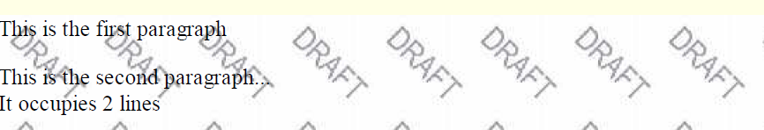
background-image
body {
background-image: url("images/draft.jpg");
}
CSS
background image/color fills the element's content area

Slide 29

background-repeat
body {
background-image: url("images/draft.jpg");
background-repeat: repeat-x;
}
CSS
can be repeat (default), repeat-x, repeat-y, or no-repeat

Slide 30
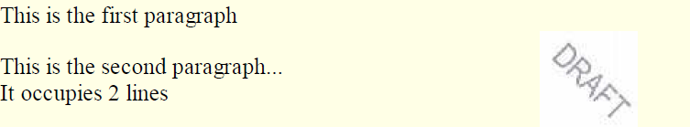
background-position
body {
background-image: url("images/draft.jpg");
background-repeat: no-repeat;
background-position: 370px 20px;
} CSS
value consists of two tokens, each of which can be top, left, right, bottom, center, a percentage, or a length value in px, pt, etc.
value can be negative to shift left/up by a given amount

Slide 31
Aside: Favorites icon ("favicon")
<link href="filename" type="MIME type" rel="shortcut icon" /> HTML
<link href="yahoo.gif" type="image/gif" rel="shortcut icon" /> HTML
The link tag, placed in the HTML page's head section, can specify an icon
this icon will be placed in the browser title bar and bookmark/favorite

Slide 32
CSS Box Model

Slide 33
What is the Box Model?
The box model is a tool we use to understand how our content will be displayed on a web page.
Each HTML element appearing on our page takes up a "box" or "container" of space.
Each box size is affected not only by content but also by padding, borders, and margins.
By knowing how to calculate the dimensions of each box, we can accurately predict how elements will lay out on the screen.
As we build a new page, we can arrange these boxes on the screen, creating a balanced layout with white space around the content.
The importance of the box model concept cannot be overemphasized. It would be difficult and frustrating to create a website without understanding this concept.

Slide 34
Box Components
Each element on the page has the following components:
Margin
Border
Padding
Content
The easiest way to understand these components is to use one of the most versatile tools available to us as web designers: the <div> element.

Slide 35
Introducing the <div> Element
The <div> ("division") element groups other elements on the screen.
By setting the width and height attributes via CSS, we can reserve a precise amount of space on our page for specific content.
The actual content is nested and contained within the opening <div> and closing </div> tags.
When we apply CSS styling directly to the <div> element, all the elements contained within that <div> will inherit that style.
By using multiple <div> elements as building blocks, we can design an entire web page layout.

Slide 36
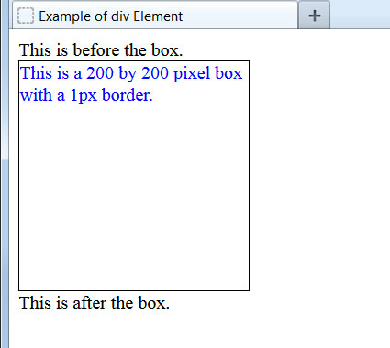
Example <div> Element
Let's create a box on the screen and add a border around it:
<style type="text/css">
.box200 {
width: 200px;
height: 200px;
border: 1px solid black;
color: blue;
}
</style>
...
This is before the box.
<div class="box200">
This is a 200 by 200 pixel box with a 1px border.
</div>
This is after the box.
...
With the border set, we can see the exact space taken up on the page.
Notice that there is almost no space separating the text from the box border. Elements such as paragraphs, headers, and lists automatically insert padding and margins, but plain text does not do so.

Slide 37
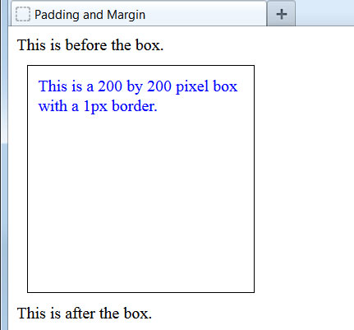
Adding Padding and Margin
Let's create some space between elements by adding both padding and margin:
<style type="text/css">
.box200 {
width: 200px;
height: 200px;
border: 1px solid black;
color: blue;
padding: 10px;
margin: 10px;
}
</style>
...
The 10 pixel padding adds buffer space, on all four sides, between the content and border. The 10 pixel margin adds buffer space, on all four sides, between the border and surrounding elements.
Let's examine this a bit closer up to see exactly what is happening.

Slide 38
Padding and Margin Illustrated
The dotted red line shows the margin's outer boundary and the dotted green line shows the padding's inner boundary.
242px high
When we define the width and height of a <div> element, these dimensions apply only to the actual content, not to the padding, border, or margin.
242px wide

Slide 39
Calculating Total Dimensions
When we are planning our page, we have to calculate exactly how much screen space a <div> or any other element will use. The formula is:
Total element width = defined width + left padding + right padding + left border + right border + left margin + right margin.
Total element height = defined height + top padding + bottom padding + top border + bottom border + top margin + bottom margin.
In our previous example:
Total <div> width = 200px + 10px + 10px + 1px + 1px + 10px + 10px = 242px.
Total <div> height = 200px + 10px + 10px + 1px + 1px + 10px + 10px = 242px.
Padding, borders, and margins do not have to be the same on all four sides, as they are in this example. Let's see how to set these individually.

Slide 40
Setting Individual Margins
We can set the specific margin sizes by using these four properties:
margin-top:
margin-right:
margin-bottom:
margin-left:
In practice, few web designers use these properties, preferring a shorthand method that condenses the declaration to a single line:
margin: 10px;
Sets all four margins to be 10px.
Sets the top and bottom margins as 10px and the left and right margins as 5px.
margin: 10px 5px;
Sets the top margin as 20px, the right margin as 10px, the bottom margin as 5px, and the left margin as 15px.
margin: 20px 10px 5px 15px;

Slide 41
Setting Individual Padding
We can set specific padding sizes by using these four properties:
padding-top:
padding-right:
padding-bottom:
padding-left:
Again, these are rarely used. Instead, the same shorthand method is employed:
padding: 5px;
Sets padding as 5px on all four sides.
Sets top and bottom padding as 25px and left and right padding as 5px.
padding: 25px 5px;
Sets top padding as 50px, right padding as 10px, bottom padding as 15px, and the left padding as 5px.
padding: 50px 10px 15px 5px;

Slide 42
Setting Individual Borders
Customizing borders is more involved. Since they are visible on the page, we have to specify style, thickness, and color. Accordingly, there are more properties available:
border-top-width:
border-right-width:
border-bottom-width:
border-left-width:
border-top-style:
border-right-style:
border-bottom-style:
border-left-style:
border-top-color:
border-right-color:
border-bottom-color:
border-left-color:
To make things easier, we can use the shorthand method as before:
border-width: 10px;
border-style: solid dashed;
border-color: blue red orange gray;
If the three border properties will be identical on all four sides, we can use a single-line border shorthand, as we did in an earlier lesson:
border: 5px solid blue;

Slide 43
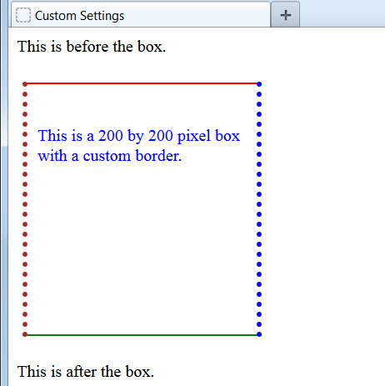

Example of Customized Settings
Here we have set custom padding, borders, and margins:
<style type="text/css">
.box200 {
width: 200px;
height: 200px;
color: blue;
padding: 40px 10px 0px 10px;
margin: 25px 5px;
border-width: 2px 5px;
border-style: solid dotted;
border-color: red blue green maroon;
}
</style>
A helpful way to remember the order of shorthand settings is that it starts at noon and goes clockwise around: top, right, bottom, left.

Slide 44
Positioning

Slide 45
Positioning Elements with CSS
With the exception of floating elements right or left, we have thus far allowed our page elements to appear one after another down the screen. Using CSS, we can depart from this normal flow in order to:
force an element to stay fixed in the same place in the browser window, even while the user continues to scroll further down the page.
move elements up, down, right, or left relative to their normal position on the page.
remove elements from their normal position and place them in a precise location within the page content.
allow elements to overlap and to specify which appears in front and which appears in back.

Slide 46
Positioning Properties and Values
The CSS position property has four different values we will use:
static - places the element in its usual location in the normal document flow. This is the default value.
fixed - removes the element from the normal document flow and fixes it to a specific location in the browser window. Even when the page is scrolled, its location will remain the same.
relative - keeps the element in the normal document flow but allows us to move it around relative to its normal location.
absolute - removes the element from the normal document flow and allows us to place it in a specific location. It will scroll along with the surrounding page content.
The position property is used in conjunction with the top, bottom, right, and left CSS properties. Let's see some examples how these work together.

Slide 47
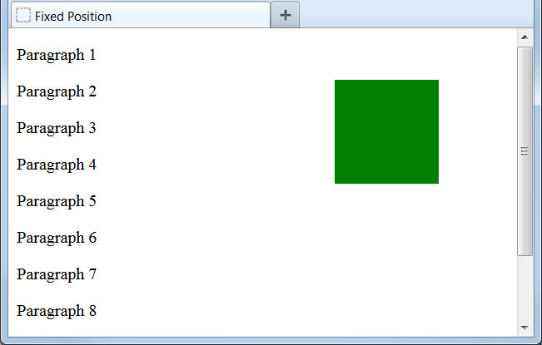
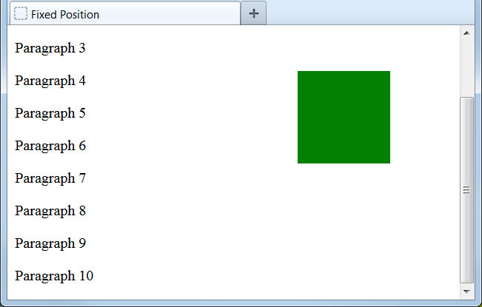
Fixed Position
Let's use the position property to fix an element to a specific location in the browser window:
.box1 {
height: 100px;
width: 100px;
background-color: green;
position: fixed;
top: 50px;
right: 75px;
}
...
<div class="box1"></div>
<p>Paragraph 1</p>
<p>Paragraph 2</p>
...
We have pinned this element to a fixed location, 50px from the top edge and 75px from the right edge of the browser window. Even as we scroll the page content, the element remains in the same place.

Slide 48
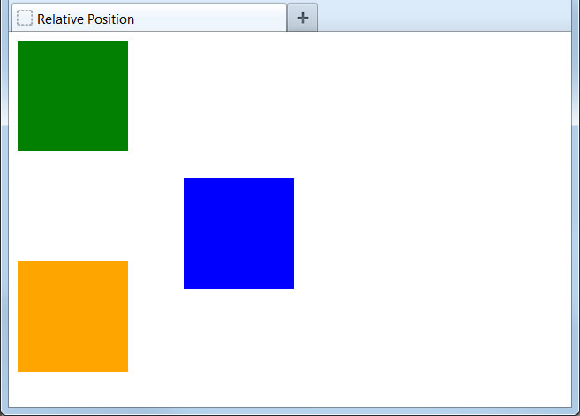
Relative Position
Now let's move an element relative to its normal position:
.box1 {
height: 100px;
width: 100px;
background-color: green;
}
.box2 {
height: 100px;
width: 100px;
background-color: blue;
position: relative;
top: 25px;
left: 150px;
}
.box3 {
height: 100px;
width: 100px;
background-color: orange;
}
...
<div class="box1"></div>
<div class="box2"></div>
<div class="box3"></div>
Using relative position, we can nudge elements or even move them to the other side of the page.
Remember that relative positioning keeps the element in the normal document flow. No matter where we move the element, its original location will be reserved on the screen.

Slide 49
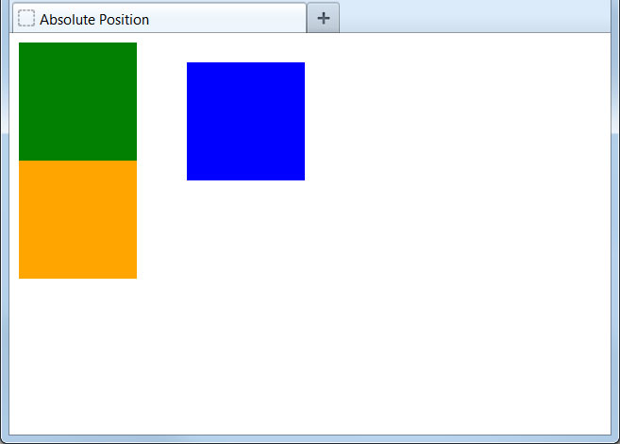
Absolute Position
Here we will change the element to have an absolute position:
.box1 {
height: 100px;
width: 100px;
background-color: green;
}
.box2 {
height: 100px;
width: 100px;
background-color: blue;
position: absolute;
top: 25px;
left: 150px;
}
.box3 {
height: 100px;
width: 100px;
background-color: orange;
}
...
<div class="box1"></div>
<div class="box2"></div>
<div class="box3"></div>
Absolute positioning places the element not relative to its normal position but from the top left corner of the page.
Like fixed positioning, absolute positioning removes the element from the normal document flow. Other elements will appear on the page the same as if this element did not exist.

Slide 50
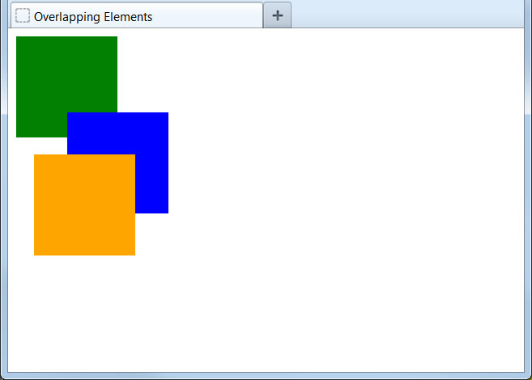
Overlapping Elements
Positioning elements can cause them to overlap on the page:
.box1 {
height: 100px;
width: 100px;
background-color: green;
}
.box2 {
height: 100px;
width: 100px;
background-color: blue;
position: relative;
top: -25px;
left: 50px;
}
.box3 {
height: 100px;
width: 100px;
background-color: orange;
position: absolute;
top: 125px;
left: 25px;
}
...
By default, the element last added to the page will appear on top of all others and the first element will appear below all others.
Note that we can set position values to be negative numbers. This can even be used to pull elements partially off the visible page.

Slide 51
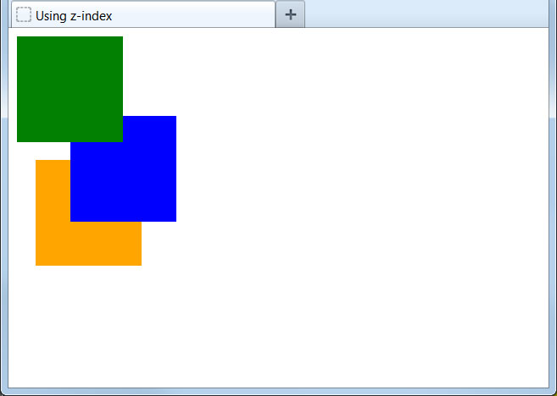
Controlling the Overlap
We can override the default precedence by setting the z-index property:
.box1 {
height: 100px;
width: 100px;
background-color: green;
position: relative;
z-index: 3;
}
.box2 {
...
position: relative;
top: -25px;
left: 50px;
z-index: 2;
}
.box3 {
...
position: absolute;
top: 125px;
left: 25px;
z-index: 1;
}
...
Higher z-index values will always appear on top of lower ones, so we can precisely control how elements stack on the page.
For the z-index to work, an element must be positioned as relative, absolute, or static.

Slide 52
CSS Table Styling

Slide 53
Using CSS to Style Tables
Up to this point, as we haven't applied any CSS styling to our tables, our example tables have not been too pleasing to the eye. CSS offers us several properties to customize how our tables appear on the page:
Style | Description
width | Width of element.
background-color | Background color of element.
color | Color of text in element.
text-align | Horizontal text alignment of element.
border | Border thickness and style of element.
padding | Padding (white space around content) of element.
We're already familiar with the color and text-align properties, but let's see examples of the other styles in action.
Though we're using these properties to style table elements, all of these properties may be used with many other XHTML elements, as we'll see in future lessons.

Slide 54
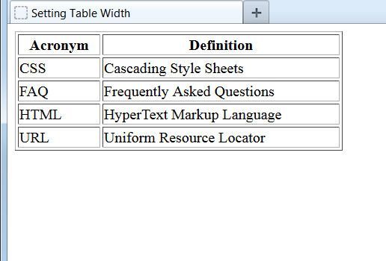
Setting Table Width
We can set the overall width of a table by applying a class to the <table> element:
<style type="text/css">
.glossary {
width: 350px;
}
</style>
...
<table class="glossary" border="1">
<tr>
<th>Acronym</td>
<th>Definition</td>
</tr>
<tr>
<td>CSS</td>
<td>Cascading Style Sheets</td>
</tr>
...
</table>
The table is now 350 pixels wide, creating some extra space in the data cells.
The width of the columns is automatically established by the browser to accommodate the cell contents, but we don't have to accept this format.

Slide 55
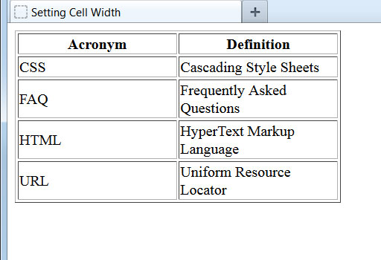
Setting Column Width in Pixels
We can set the width of columns by setting the widths of the first row of data cells:
<style type="text/css">
.glossary {
width: 350px;
}
.col {
width: 175px;
}
</style>
...
<table class="glossary" border="1">
<tr>
<th class="col">Acronym</td>
<th class="col">Definition</td>
</tr>
<tr>
<td>CSS</td>
<td>Cascading Style Sheets</td>
</tr>
...
</table>
We've now set each of the columns to be 175 pixels in width, or half of the total available table width.
Notice that due to the enforced width, some cell contents had to wrap to an additional line.

Slide 56
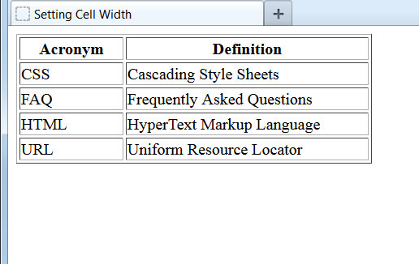
Setting Column Width in Percent
Rather than pixels, we can also set column widths to be a percent of the total available width:
<style type="text/css">
.glossary {
width: 350px;
}
.col1 {
width: 30%;
}
.col2 {
width: 70%;
}
</style>
...
<table class="glossary" border="1">
<tr>
<th class="col1">Acronym</td>
<th class="col2">Definition</td>
</tr>
...
</table>
Setting column widths by percent instead of pixels has the advantage of flexibility. Should we ever alter the width of the table itself, the columns will automatically adjust.

Slide 57
Borders
CSS provides us plenty of flexibility when generating borders around elements. There are multiple properties that affect the border that displays on the page:
Style | Description
border-style | Type of border: none, solid, dashed, dotted, double, groove, ridge, inset, outset.
border-color | Color of border.
border-width | Width of border, measured in pixels. Also available: thin, medium, and thick.
border-collapse | collapse: borders display as single border. separate: borders are detached (default).
We'll examine each of the first three, but first let's take a look at the border-collapse property.

Slide 58
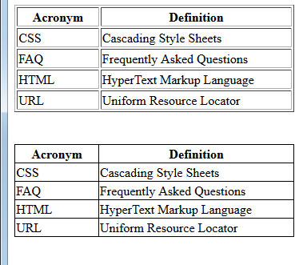
The border-collapse Property
By invoking the border-collapse property, we can force a table to collapse its borders into a single line between cells:
<style type="text/css">
.glossary {
width: 350px;
}
.collapse {
border-collapse: collapse;
}
...
</style>
...
<table class="glossary collapse" border="1">
<tr>
<th class="col1">Acronym</td>
<th class="col2">Definition</td>
</tr>
...
</table>
Here we created an identical table but added a class that included the border-collapse property.

Slide 59
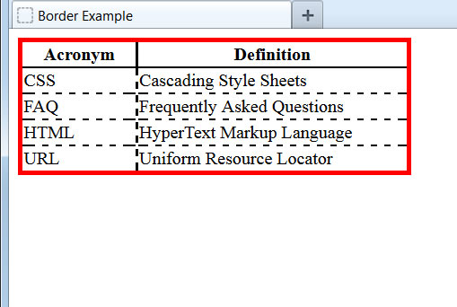
Customizing Borders
By using the other three properties, we can create custom borders for our table:
<style type="text/css">
.glossary {
width: 350px;
border-width: 4px;
border-style: solid;
border-color: red;
}
th {
border-width: 2px;
border-style: solid;
}
td {
border-width: 2px;
border-style: dashed;
}
...
Notice that we can apply different styles to the table, table headers, and table cell elements.
For demonstrative purposes, we applied CSS styles directly to the <th> and <td> elements, instead of using separate classes. In the real world, this would likely be a bad idea, as any other tables on our page would be affected too.

Slide 60
Using CSS Border Shorthand
When specifying multiple border properties, we can use the CSS border shorthand to reduce the statement to a single line:
<style type="text/css">
.glossary {
width: 350px;
border-width: 4px;
border-style: solid;
border-color: red;
}
th {
border-width: 2px;
border-style: solid;
}
td {
border-width: 2px;
border-style: dashed;
}
...
<style type="text/css">
.glossary {
width: 350px;
border: 4px solid red;
}
th {
border: 2px solid;
}
td {
border: 2px dashed;
}
...
By convention, the properties are ordered as border: border-width border-style border-color; (The color portion may be omitted.)

Slide 61
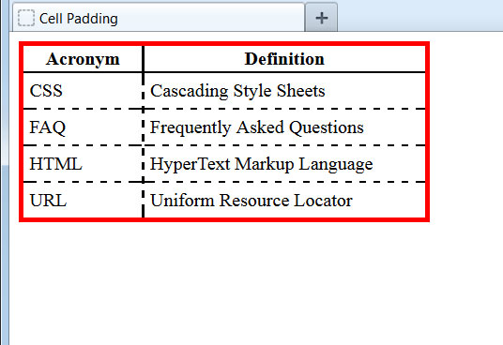
Adding Cell Padding
By setting the padding property, we can make sure there is at least that much white space around our cell contents. This keeps the actual cell contents from displaying too closely to the borders:
<style type="text/css">
.glossary {
width: 350px;
border: 4px solid red;
}
th {
border: 2px solid;
}
td {
border: 2px dashed;
padding: 5px;
}
...
Different border and padding settings can be set for the top, bottom, left, and right sides of elements. We will learn how to do this in an upcoming lesson.

Slide 62
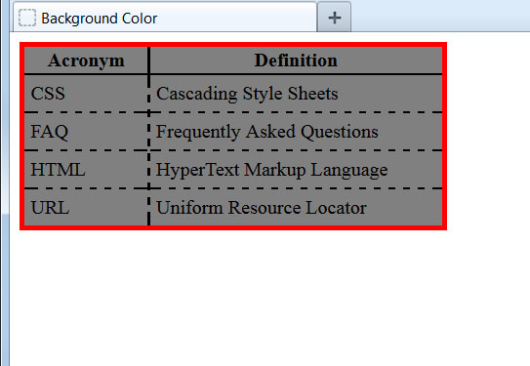
Setting a Background Color
By setting the background-color property, we can change our table's background away from the default:
<style type="text/css">
.glossary {
width: 350px;
border: 4px solid red;
background-color: gray;
}
th {
border: 2px solid;
}
td {
border: 2px dashed;
padding: 5px;
}
...
Let's use this property now on the data cells to make our table a bit more readable.

Slide 63
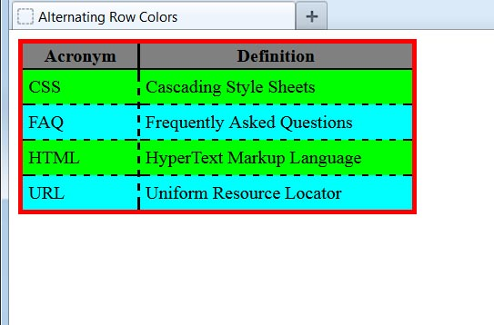
Using Background Color on Rows
<style type="text/css">
...
.odd {
background-color: lime;
}
.even {
background-color: aqua;
}
...
</style>
...
<tr class="odd">
<td>CSS</td>
<td>Cascading Style Sheets</td>
</tr>
<tr class="even">
<td>FAQ</td>
<td>Frequently Asked Questions</td>
</tr>
<tr class="odd">
...
This is a handy way to make our table rows show in alternating background colors. This technique makes reading wide tables far easier for viewers.

